Slide 1

Wisconsin Department of
Safety and Professional Services
Introduction to Wisconsin Amusement Ride Program and eSLA.
WACO
March 14th, 2024

Slide 2
What is an amusement ride?
Amusement rides are defined in SPS 334 Amusement Rides
“Amusement ride” means a device or animal that carries, transports or supports passengers in unusual, entertaining or thrilling modes of motion and any vehicle providing entertainment or transportation in conjunction with an amusement ride, including rider−powered and power−driven thrill rides, mild rides and ride− throughs, walk−throughs, air pillows, giant slides, and animal rides. Vehicles include parking lot trams, old fire engines, stage coaches and trains. “Amusement ride” does not include any of the following:
  Aircraft under the jurisdiction of the federal aviation administration.
  Railroad trains under the jurisdiction of the federal railroad administration.
  Boats used on navigable waters.
  Animal rides where the animal is under the control of the passenger.
  Hang gliders and parachutes
  Climbing walls that do not involve a mechanical take−up or release system.

Slide 3
How are amusement rides classified?
Class 1
  Class 1 shall consist of amusement rides that are properly designed, constructed and maintained to move passengers in a mild manner.
Class 2
  Class 2 shall consist of amusement rides that are properly designed, constructed and maintained to move passengers in a thrilling manner.
Class 3
  Class 3 shall consist of those amusement rides which do not meet the requirements for the classes 1 or 2 of amusement rides

Slide 4
What amusement rides may be found at a campground?
Jumping Pillows
Inflatables
Trackless Trains (Barrel Train, Trams, etc.)
Go Karts
Fun House
Climbing Wall(with mechanical take-up device)
Coin Operated Devices
Other devices used for transporting passengers

Slide 5
What about playground equipment?
SPS 334.002 specifically excludes playground equipment.
EXCLUSIONS. The provisions of this chapter do not apply to nonmechanized playground equipment, such as swings, seesaws, stationary spring mounted animal features, rider propelled merry−go−rounds, climbers, slides, swinging gates and physical fitness devices.

Slide 6
Registration and renewals of amusement rides
Amusement Rides must be registered prior to operation to the public. Registration is $55 per year and permits expire on 12/31 each year regardless of registration date.
Proof of insurance must be submitted with the registration or renewal.
  $1,000,000 per occurrence against liability/ $500,000 for coin-operated ride
  DSPS must be listed as a certificate holder from the insurance company
  Certificate of Insurance must list the ride name and serial number as provided to us during registration or renewal
All prior fees must be paid
Any prior open orders must be corrected
Itinerary submitted for the operating year

Slide 7
Department Inspections
An amusement ride for which plans must be submitted for review under s. SPS 334.05 may not be opened to the public until the ride has been inspected by the department or its authorized representative.
The owner shall notify the department when the construction or installation of an amusement approved under s. SPS 334.05 is complete and at least 5 business days prior to the ride being open to the public to provide for the inspection
Every amusement ride shall be subject to periodic inspections conducted by the department or its authorized representative.

Slide 8
Department Fees
Plan review for engineering analysis and test data - $280.00
Annual registration fee - $55.00
Late Registration/ Failure to register prior to opening to the public - $ 200.00
Periodic Inspection of Coin operated kiddie ride - $75.00
Periodic Inspection of Class 1 amusement ride - $140.00
Periodic Inspection of Class 2 amusement ride- $250.00
Reinspection for noncompliance with previously issued orders - $100.00

Slide 9
Inspections and Operational Tests
INSPECTION AT ASSEMBLY. A visual inspection for defects of the amusement ride shall be made at assembly of the ride. Inspection of all fastening devices shall be made to assure that fasteners recommended by the manufacturer have been properly installed
DAILY INSPECTION AND OPERATIONAL TESTS. Amusement rides shall be inspected and their operation tested each day before use by frequenters. The inspection and operational test shall include the operation of all control devices, speed−limiting devices, brakes and other equipment provided for safety.
  Coin−operated amusement rides shall be inspected and operation tested at least once a week.

Slide 10
Nondestructive Testing
Nondestructive Tests. A nondestructive test, such as but not limited to magnetic particle, x−ray, dye penetrant or ultrasonic, shall be performed on the ride in accordance with recognized safe practice
  When required in accordance with recognized safe practice, nondestructive tests of all class 1 and class 2 amusement rides shall be performed every 3 years or 3,000 hours of operation, whichever comes first, or at testing intervals required by the manufacturer. The time interval shall be based upon the date of the previous test report.
  RECORD OF TESTS. The test method and results shall be documented by the person conducting the test. Test documentation shall be maintained and made available to the department
  TEST CONDUCTOR. The nondestructive test shall be performed by an individual who has achieved a rank of at least level II technician certified by the American Society for Nondestructive Testing or by a professional engineer

Slide 11
Record Keeping
Records related to amusement ride safety shall be kept and retained by the amusement ride owner and shall be made available to the department upon request
  Each amusement ride owner shall prepare an operating fact sheet for each amusement ride regarding operating policies and procedures. The fact sheet shall be made available to each ride or device operator and attendant.
Records shall be kept of the following
  Inspections at the time of assembly
  Daily inspections and operational tests
  Nondestructive tests
  The hours of operation since the last nondestructive test
Retention of records
  Records for the 30 previous days of operation and most recent nondestructive test shall be kept with the amusement ride
  All other records shall be kept for 7 years.

Slide 12
Operation and Training
The operation of an amusement ride shall be by an authorized person at least 18 years of age except for any of the following rides:
  Passenger−operated or passenger−controlled rides.
  Electrically−powered, coin−operated class 1 amusement rides having a maximum capacity of 6 passengers. (Note: See s. DWD 270.12, Wis. Adm. Code, concerning hazardous occupations prohibited to all minors.)
An amusement ride owner shall provide training for ride operators and attendants. The owner shall maintain record of the training and shall make the record available to the department upon request.

Slide 13
Public Protections
Amusement rides shall be fenced, barricaded or otherwise arranged in accordance with recognized safe practice so that frequenters are effectively prevented from entering hazardous areas.
When fences are provided in accordance with the above they shall be constructed to meet all of the following requirements.
  Fences shall be a height of at least 42 inches above the surface on which the spectators or riders stand
  Fences shall be constructed in such a fashion so as to reject a 4−inch ball at all openings, including between the bottom of the fence and the surface upon which it rests
  Fences shall be designed, constructed and erected to inhibit overturning by spectators or riders.
  Where used, gates shall open away from the ride unless equipped with a positive latching device
  Gates shall be designed such that if opened during the amusement ride cycle, the gate will not contact the amusement ride or cause a hazard to riders

Slide 14
Accident Reporting
Injuries to frequenters caused by amusement rides that require more than first aid treatment shall be reported by the owner to the department on form SBD−211 within 2 business days of the injury. A copy of the owner’s report to the insurance carrier may be submitted in place of form SBD−211 if the report includes the same information as the form. Fatalities caused by amusement rides shall be reported to the department or the state division of emergency management within 24 hours of occurrence.
  Can be submitted from the Permit option menu in eSLA
  Emailed to your areas DSPS Safety Inspector
  Emailed to the Public Sector Safety Groups email at dspssbsafetyandhealthtech@wisconsin.gov
  Can be called in at 608-266−7548

Slide 15
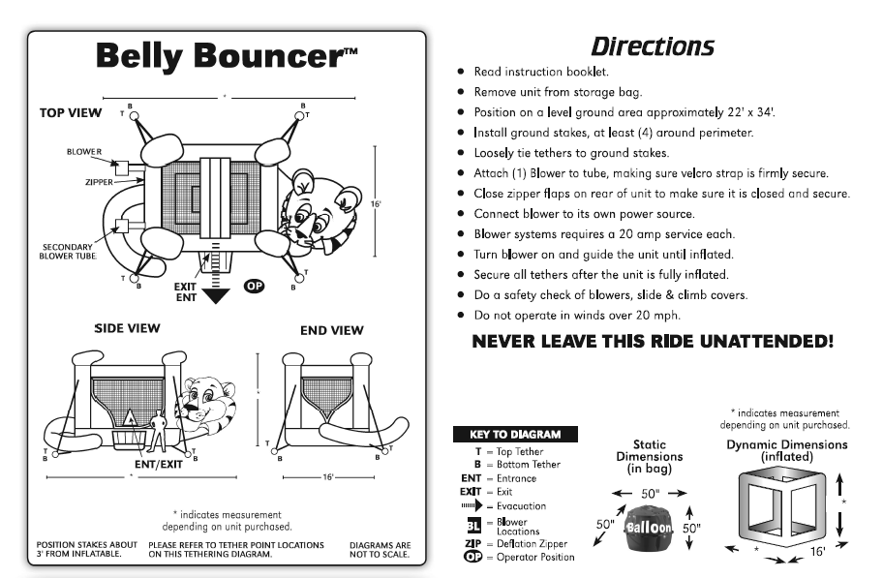
Amusement Ride Fact Sheet and Daily Checklist Information

Slide 16
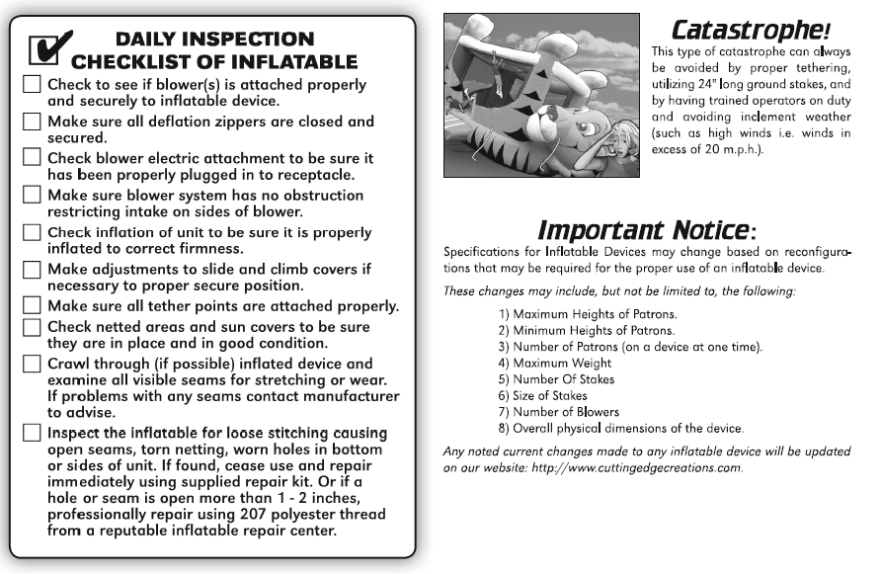
Amusement Ride Fact Sheet and Daily Checklist Information

Slide 17
Where can I find more information on amusement rides?
The full SPS 334 administrative code for Amusement Rides can be found here: https://docs.legis.wisconsin.gov/code/admin_code/sps/safety_and_buildings_and_environment/326_360/334.pdf
Information on the DSPS amusement ride program can be found on our website here: https://dsps.wi.gov/Pages/Programs/AmusementRides/Default.aspx
  Links to code archives
  Most recent Public Sector Safety District Map
  Accident Reporting information
  eSLA customer guides
  Frequently asked questions

Slide 18


Amusement Ride Questions?

Slide 19
What is eSLA?
eSLA – Electronic Safety Licensing Application
Allows electronic processing and renewals for -
  Credentialing
  Plan Review
  Permits to Operate
Electronic payment processing
  E-Check
  Credit Cards

Slide 20
What might your campground use eSLA for?
Registering and renewing Amusement Rides
Paying for boiler, pressure vessel, and refrigeration renewals
Obtaining boiler pressure vessel and refrigeration PTO
Paying for elevator renewals
Obtaining elevator PTOs
Submitting Private Onsite Wastewater Treatment Systems (POWTS) plan review
Submitting public swimming pool plan review
Submitting a new commercial building plan review
Credentialing and Licensing

Slide 21
eSLA Glossary
User Profile – An individuals login used to access a business account in eSLA
Business Account – Where your permits, plan reviews, and inspections are kept
  A User Profile is linked to a business account
Permit To Operate – Printable permits issued after inspection and payment for Boilers, UPVs, Refrigeration and elevators.
Permits – Any device that is regulated through DSPS (Boilers, elevators, etc)
Permit Applications – Any electronic application or report sent to DSPS. (IIR)

Slide 22
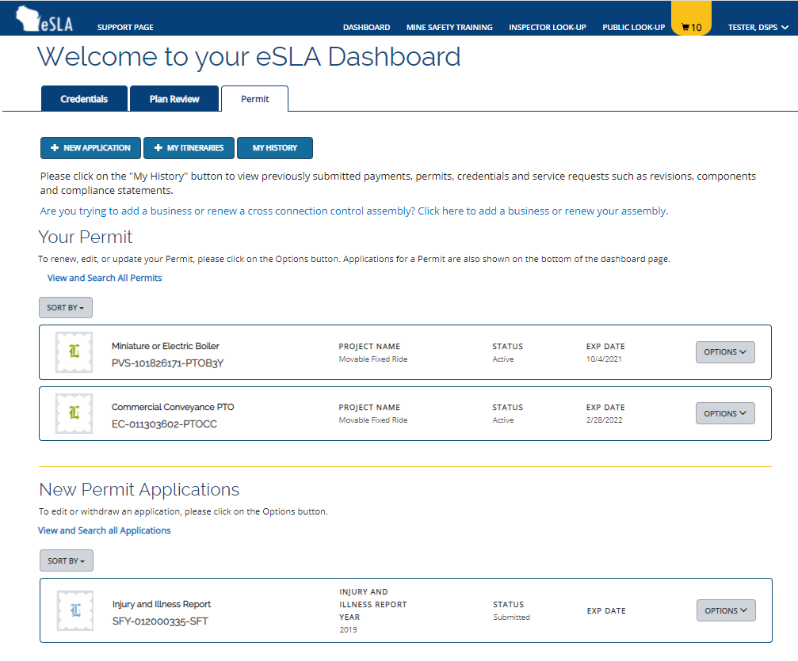
eSLA Dashboard

Slide 23
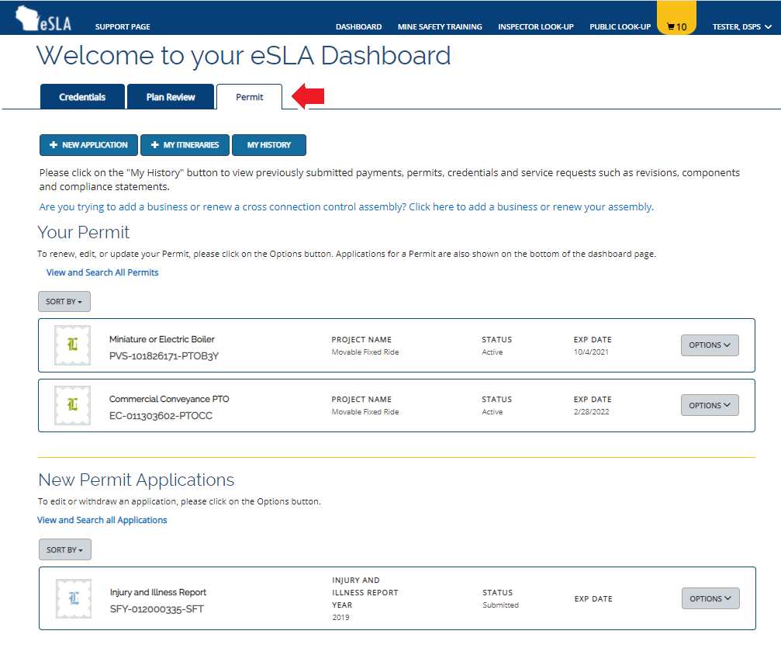
eSLA Dashboard – Program area tabs

Slide 24
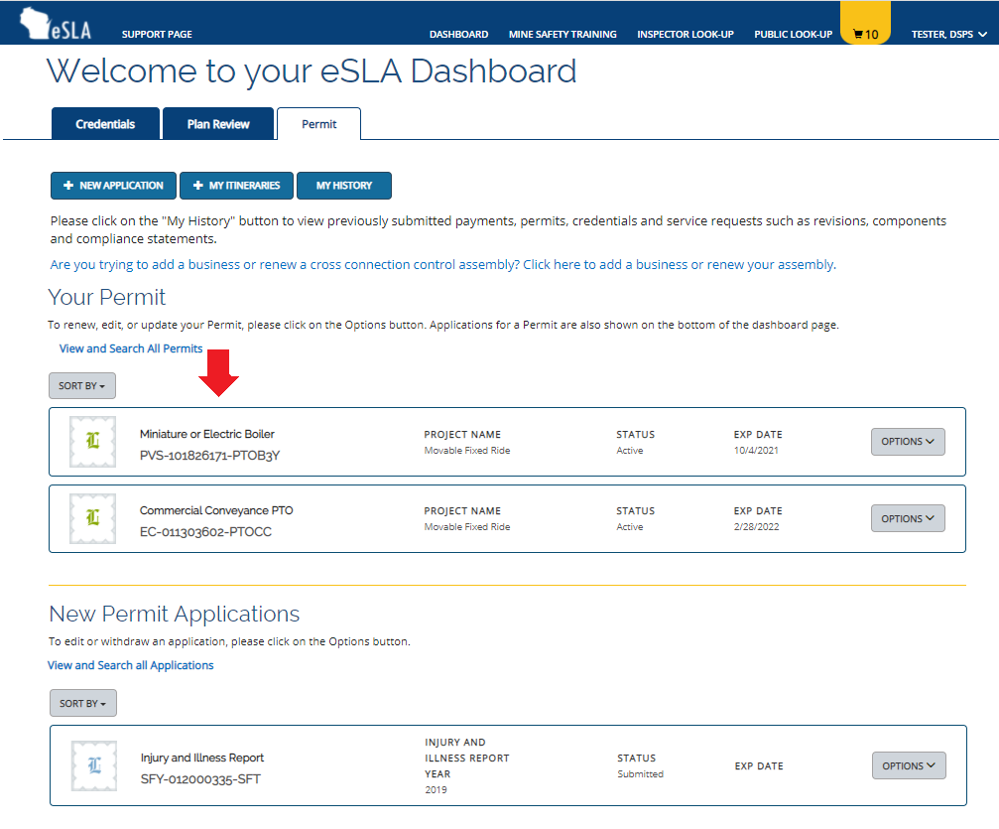
eSLA Dashboard – Permit To Operate

Slide 25
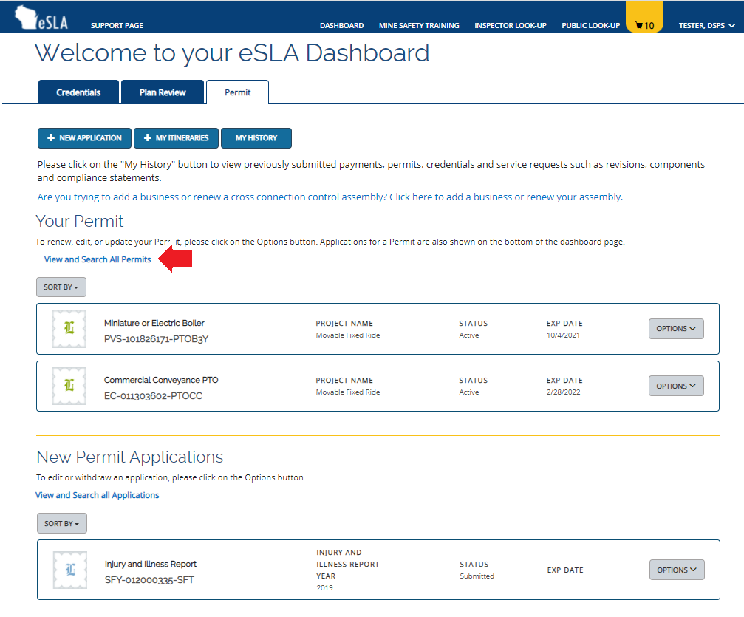
eSLA Dashboard – View all permits

Slide 26
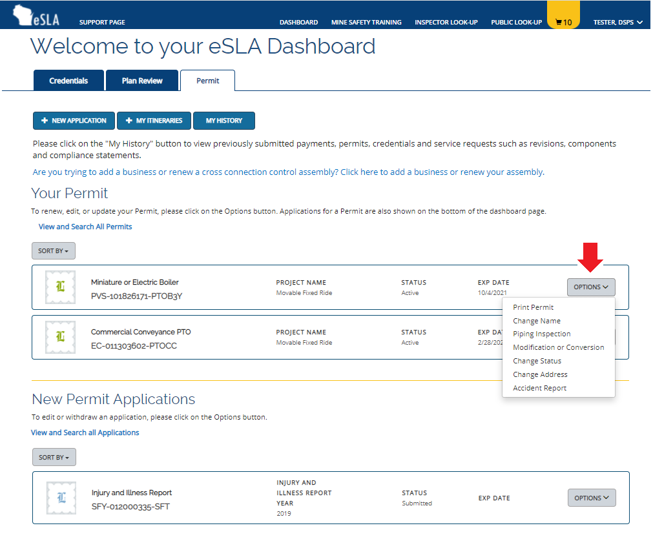
eSLA Dashboard – PTO Options

Slide 27
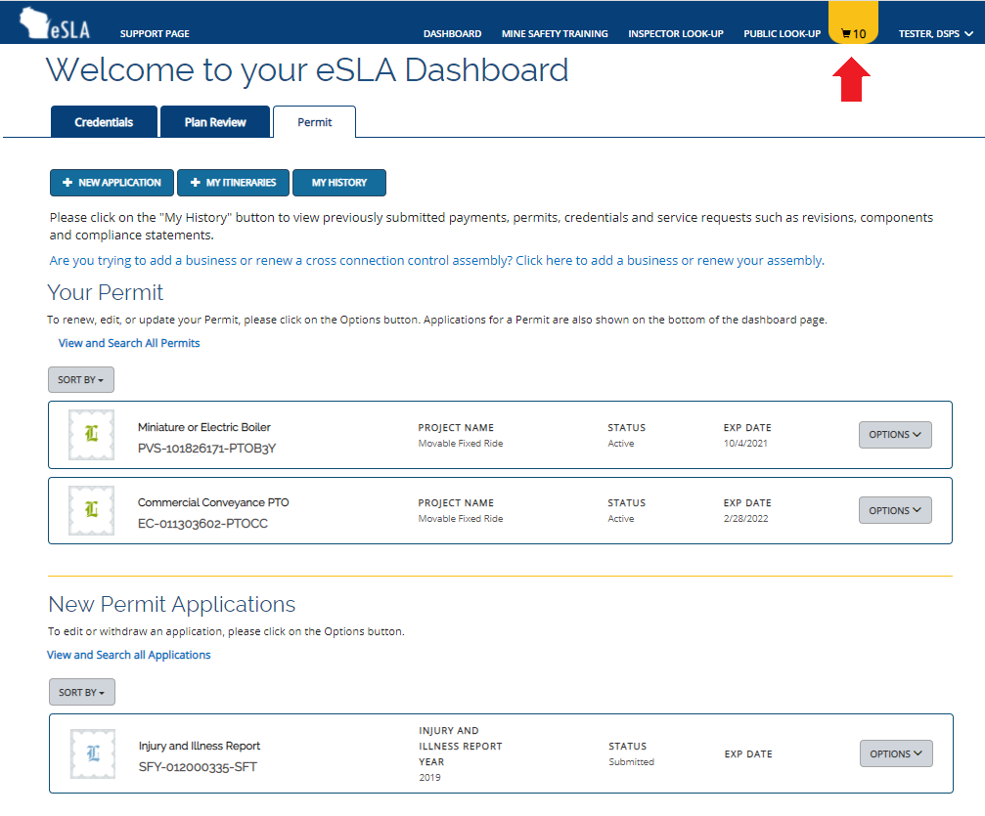
eSLA Dashboard – Payment Cart

Slide 28
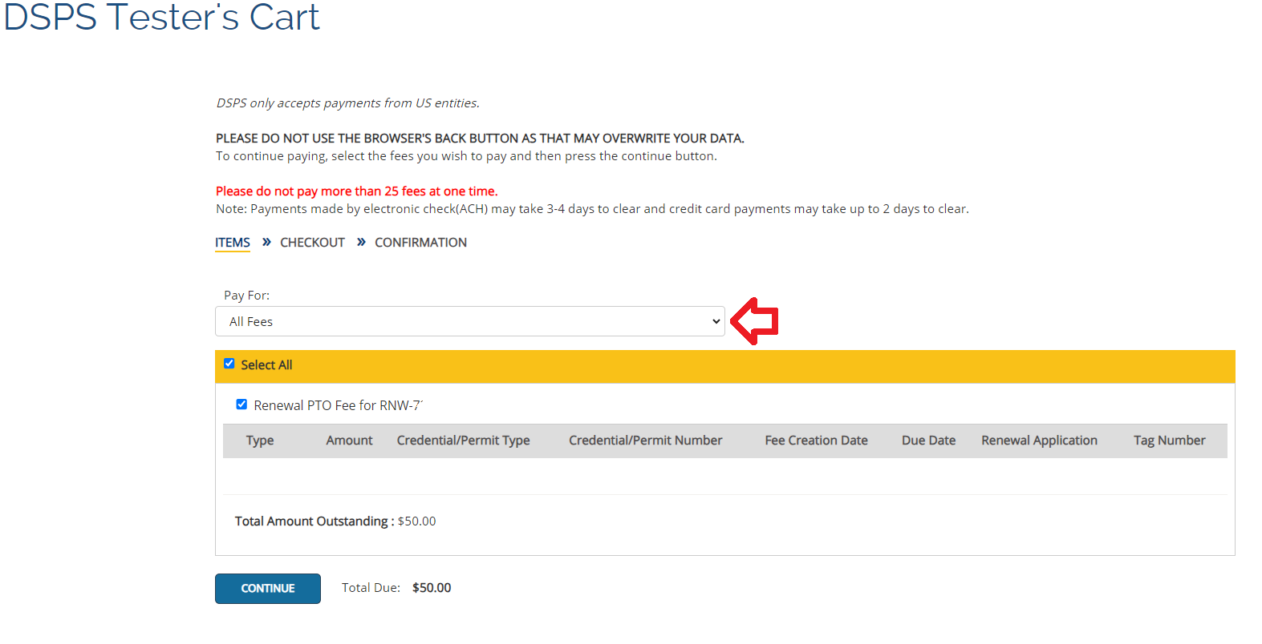
eSLA Dashboard – Cart Page

Slide 29
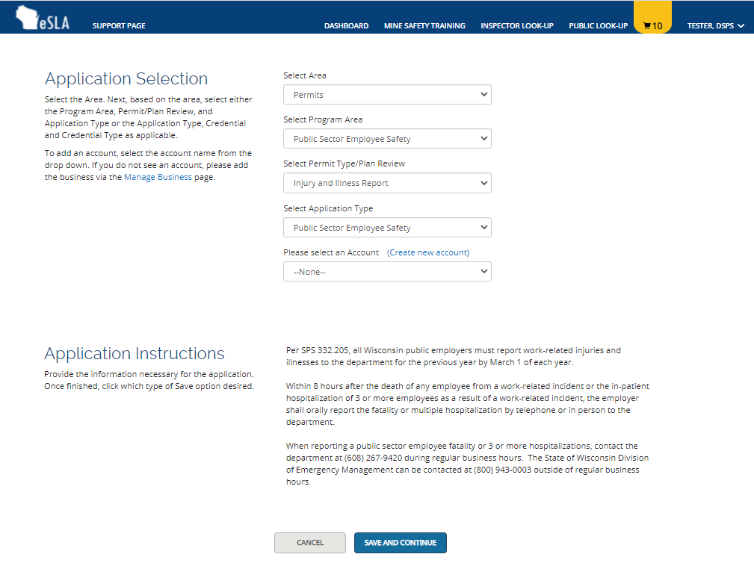
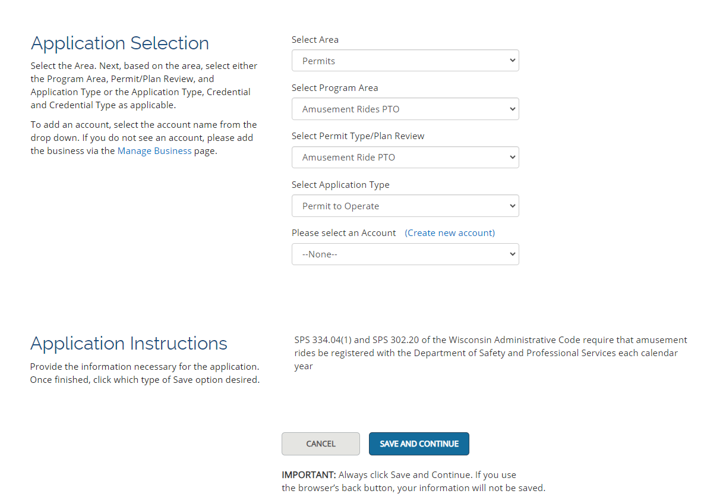
eSLA Dashboard – Application Page

Slide 30
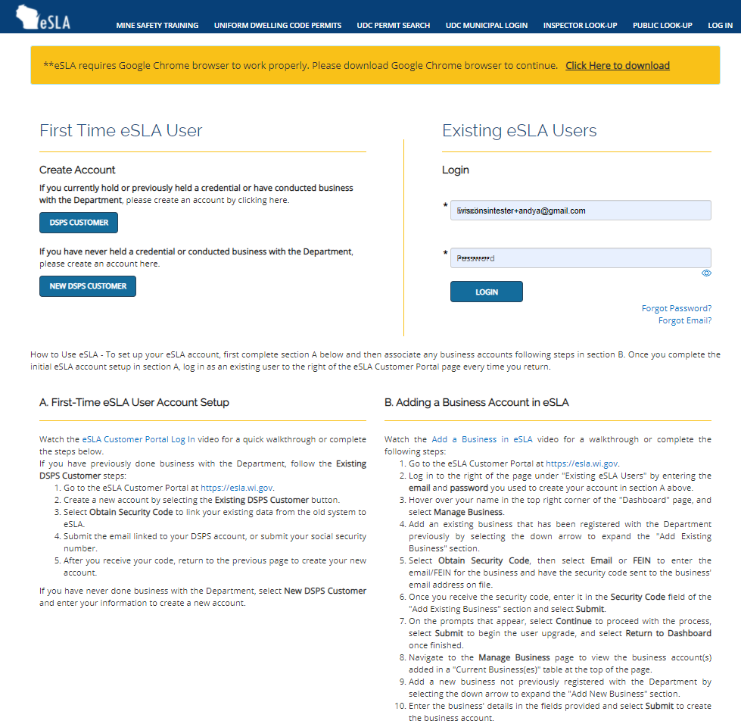
eSLA Website – esla.wi.gov

Slide 31
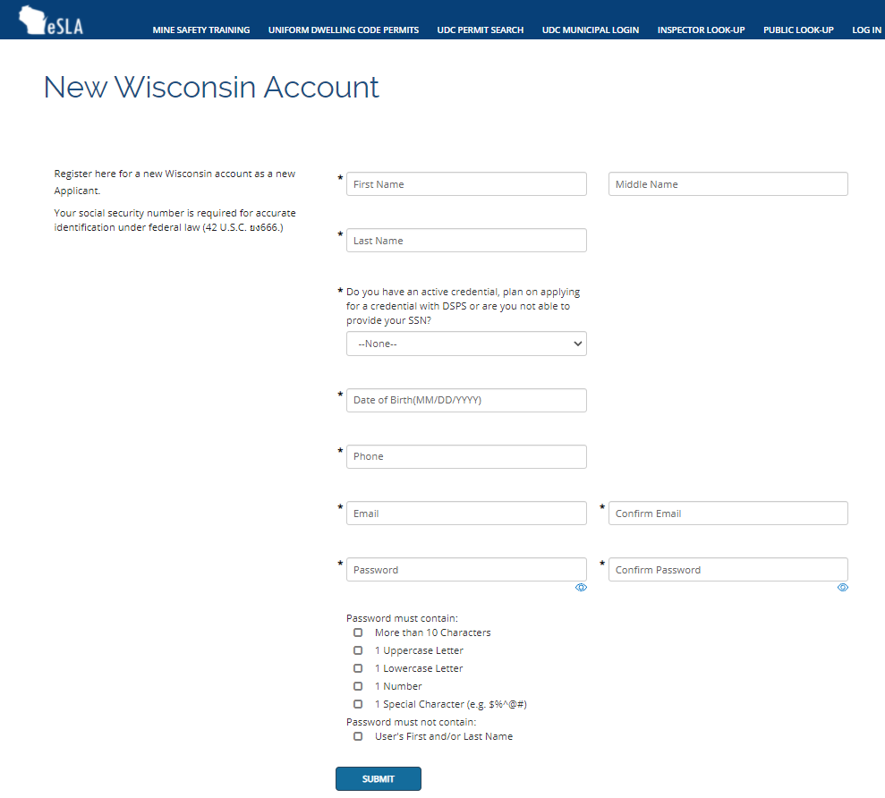
eSLA Account – New DSPS Customer Account
Used to create accounts for new DSPS customers.
May use “No- I do not have an active credential” for SSN question if you do not have an active credential. This will only require the last 4 as a unique marker with your name to ensure duplicate accounts are not created in the system.
Most users fall under this registration type.

Slide 32
Common eSLA Questions and Tips
Can I use the same account profile for multiple business accounts?
  Yes, each time a new plan review or permit is submitted, you will be prompted to select the account in which you wish to use.
Can multiple people manage the same PTO?
  At this time only one person can be assigned each PTO.
Why can I not see past plan reviews or permits?
  The person who created the report has access to it via their dashboard. If it needs to be moved to your account, please contact your DSPS Safety Inspector to assist you in moving them.
I am getting an error or a “Visual Force Page Error”.
  This can be a common issue with new accounts, usually it is just an account setting. Your DSPS Safety inspector will be able to assist you.
If you create a new DSPS account, please reach out to your DSPS Safety Inspector to be linked to your business account. In most situations, there is an account already created from prior plan revies or permits.

Slide 33
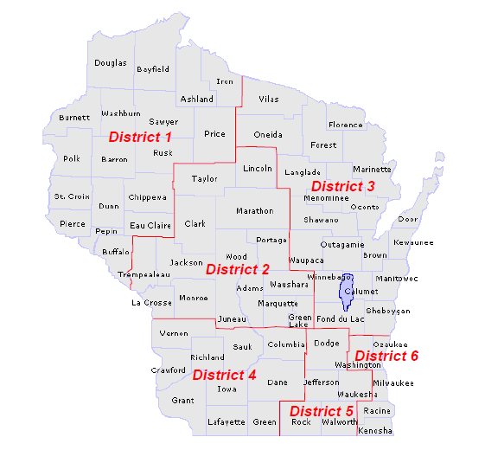
1- Jane Dienger
715-538-3308
Jane.Dienger@Wisconsin.gov
2- Rhonda Kocijan-Klecz
608-982-6496
rhonda.kocijanklecz1@wisconsin.gov
3- Tim Condon
414-852-3660
Timothy.Condon@Wisconsin.gov
4- Andrew Amacher
608-438-8061
Andrew.Amacher@Wisconsin.gov
5- Richard Lampi
608-720-0007
richard.lampi@wisconsin.gov
6- Jim Creegan
608-219-7185
James.Creegan@Wisconsin.gov
Supervisor:
Lucas Dederich
608-445-6558
Lucas.Dederich@Wisconsin.gov

Slide 34
Questions?
Andrew Amacher
608-438-8061
Andrew.Amacher@Wisconsin.gov
General inquiries and assistance
Public Sector Safety Group Email
dspssbsafetyandhealthtech@wisconsin.gov
Tim Condon
414-852-3660
Timothy.Condon
@Wisconsin.gov
Lucas Dederich
608-445-6558
Lucas.Dederich
@wisconsin.gov

